Slide 1
Get a CluE: Ensemble Clustering with Chicago Housing Data
David Liao & Cara Bowen-Goldberg

Slide 2
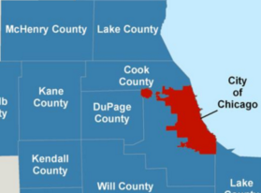
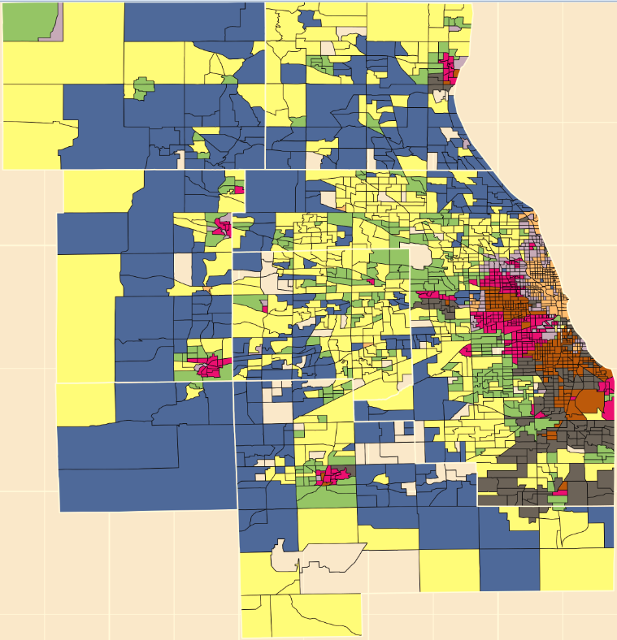
7 Counties Housing Data
Source: US Census, ACS and others via the DePaul Institute for Housing Studies
Observations: 1,980 census tracts of the 7 counties of Chicagoland area
Features: 90 attributes, each for years 2000 and 2013, of socioeconomic data
demographics
housing tenure
household income
housing costs
Education
population density
age of housing
housing density
Two subsets: one for 2013, and one for ‘Change Over Time’ from 2000 to 2013.

Slide 3
Goal (Problem / Motivation)
Can Ensemble Clustering help find optimal K (# of clusters)?
Try to improve on the single cluster partitions found
What happens when inappropriate algorithm is used with Ensemble Clustering?
Clustering Quality Validation Indices – performance of Ensemble vs Single Algorithms

Slide 4
Methodology
Apply single clustering with several different algorithms
k-means: Hartigan-Wong vs Lloyd (Forgy) vs MacQueen
Also: PAM k-medoids, Fuzzy c-means, DBscan
Choose optimal base clustering algorithm and parameters
PAM, Euclidean, k=8
Repeat using cluster ensembles and consensus clustering
Ensembles of single-runs of different algorithms
Ensembles of multiple runs of the same algorithm
Consensus methods: BagClust1, Soft Euclidean, GV3 (SUMT variant)
Compare single clustering to consensus clustering
internal validation quality indexes – choose carefully
external validation with geographical maps
This is an Ensemble method, but NOT a classification method
Our data is not labeled – we must find different metrics for quality & validity
We use all our data to build partition models – no train/test split

Slide 5
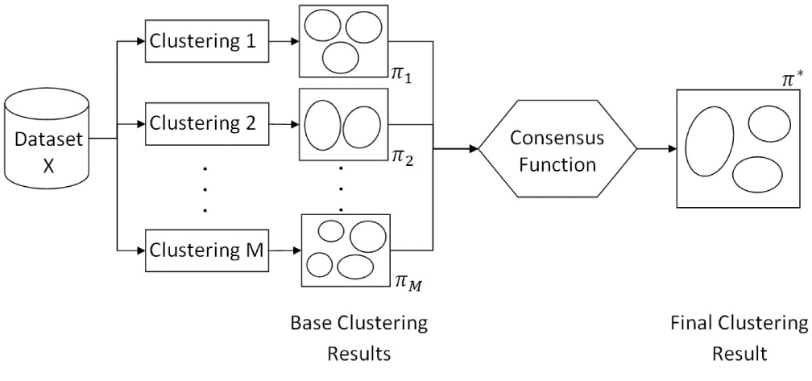
Ensemble Clustering: How It Works
Natthakan Iam-On, Tossapon Boongoen, Simon Garrett, Chris Price, "A Link-Based Cluster Ensemble Approach for Categorical Data Clustering,"
IEEE Transactions on Knowledge and Data Engineering, vol. 24, no. 3, pp. 413-425, March, 2012

Slide 6
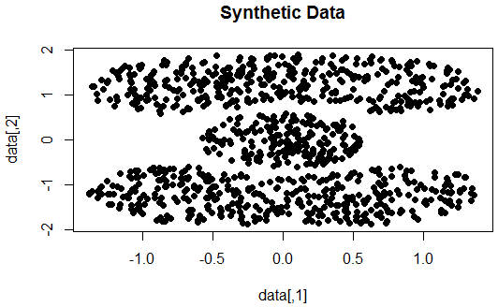
Methodology applied to ‘Toy’ Data
Use a synthetic two-dimensional dataset, “Cassini”, to warm up
Unlike Chicago data, this ‘toy’ data has very distinct clusters
2 non-convex, banana-shaped clusters curve around 1 circular cluster

Slide 7
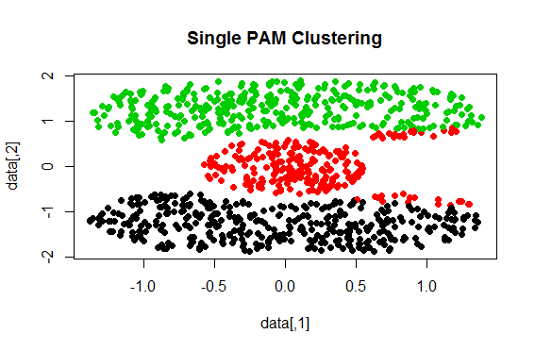
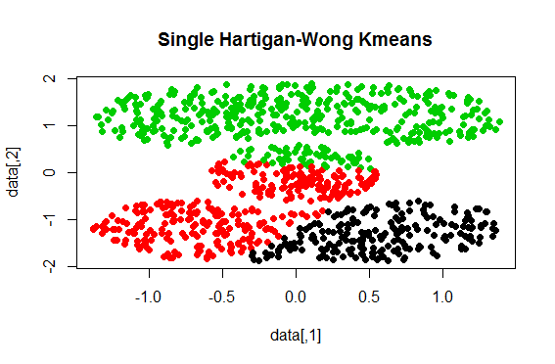

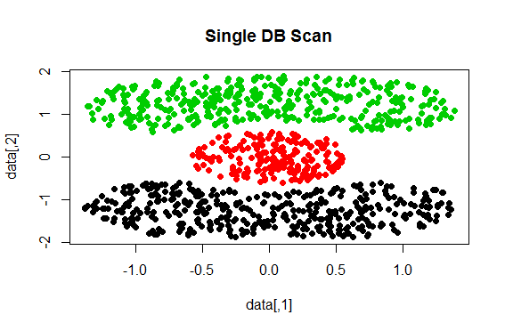
Single Clustering: Kmeans, Cmeans, PAM, DBScan

Slide 8
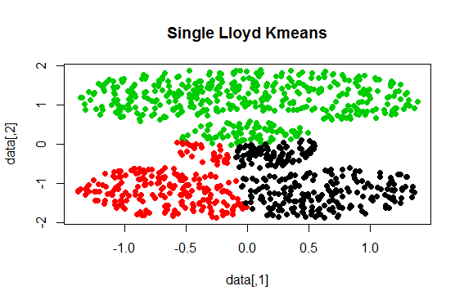
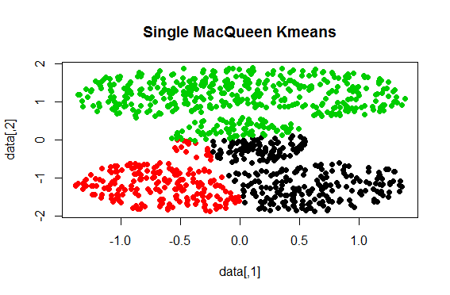
Single Clustering: 3 Variations on Single Kmeans

Slide 9
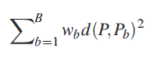
SE Consensus of Clustering -- Example
“Given an ensemble of partitions P₁,...,P_{B} of the same n objects and weights w₁,...,w_{B} summing to one, a soft Euclidean consensus partition (generalized mean partition) is defined as a partition which minimizes
 | 3 Bootstrap Replicates of Hartigan-Wong k-means Partitions |  |  | SE Consensus per Cluster |  |  | OPTIONAL
Obs | Rep1 | Rep2 | Rep3 | C1 | C2 | C3 | Hard Cluster
1 | 3 | 3 | 2 | 0.67 | 0 | 0.33 | 1
2 | 3 | 3 | 1 | 1 | 0 | 0 | 1
3 | 1 | 2 | 3 | 0 | 0.33 | 0.67 | 3
4 | 3 | 3 | 2 | 0.67 | 0 | 0.33 | 1
5 | 2 | 1 | 3 | 0 | 1 | 0 | 2
6 | 1 | 2 | 1 | 0.33 | 0 | 0.67 | 3
7 | 3 | 3 | 1 | 1 | 0 | 0 | 1
over Ƥ_{v} for a given v”.
K. Hornik and W. B¨ohm, Data Analysis, Machine Learning and Applications: Proceedings of the 31st Annual Conference of the Gesellschaft f¨ur Klassifikation e.V., Albert-LudwigsUniversit¨at Freiburg, March 7–9, 2007, ch. Hard and Soft Euclidean Consensus Partitions, pp. 147–154. Berlin, Heidelberg: Springer Berlin Heidelberg, 2008.

Slide 10
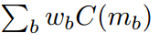
GV3 Consensus of Clustering -- Example
 | 3 Bootstrap Replicates of Hartigan-Wong k-means Partitions |  |  | GV3 Consensus per Cluster |  |  | OPTIONAL
Obs | Rep1 | Rep2 | Rep3 | C1 | C2 | C3 | Hard Cluster
1 | 3 | 3 | 2 | 0 | 0.98 | 0.02 | 1
2 | 3 | 3 | 1 | 0.22 | 0.78 | 0 | 1
3 | 1 | 2 | 3 | 0.68 | 0 | 0.32 | 3
4 | 3 | 3 | 2 | 0 | 0.98 | 0.02 | 1
5 | 2 | 1 | 3 | 0 | 0 | 1 | 2
6 | 1 | 2 | 1 | 0.98 | 0.02 | 0 | 3
7 | 3 | 3 | 1 | 0.22 | 0.78 | 0 | 1
“A SUMT algorithm for the “third model” in Gordon and Vichi (2001) for minimizing L with d being co-membership dissimilarity.
Equivalent to finding the membership matrix m for which the sum of the squared differences between C(m) = mm’ and the weighted average co-membership matrix
of the partitions is minimal.”
Hornik K (2016). _clue: Cluster ensembles_. R package version 0.3-51, <URL: https://CRAN.R-project.org/package=clue>.
Hornik K (2005). “A CLUE for CLUster Ensembles.” _Journal of Statistical Software_, *14*(12). <URL: http://doi.org/10.18637/jss.v014.i12>.

Slide 11
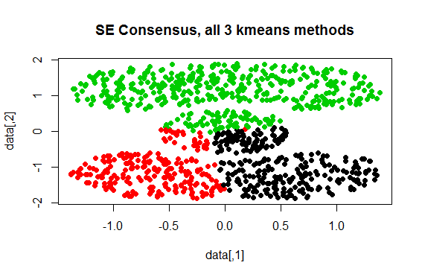
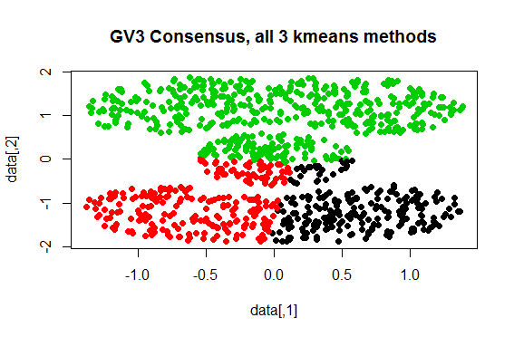
Ensemble and Consensus with Single Kmeans - one ensemble of the three single kmeans algorithms - 2 different consensus methods: SE and GV3

Slide 12
Bagging Clustering with BagClust1
STEPS:
Form one original partition with a given base clustering algorithm, and obtain cluster labels for each observation.
Form the bth bootstrap sample.
Apply the same clustering procedure to this new sample, and obtain cluster labels for each observation.
Permute this new set of cluster labels so that there is maximum overlap between this one and the original one obtained in step 1.
This is necessary due to instability of cluster assignment (eg 1-2-3 permutes to 3-1-2)
Repeat steps 2-4 B times.
After finishing all B iterations, assign a bagged cluster label for each observation by majority vote, which is the proportion of total votes in favor of winning the cluster assignment.
Sandrine Dudoit, Jane Fridlyand, “Bagging to improve the accuracy of a clustering procedure”, Bioinformatics, vol. 19, no.9, pp. 1090-1099, 2003.

Slide 13
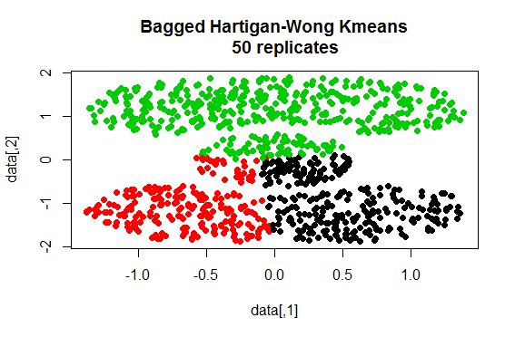
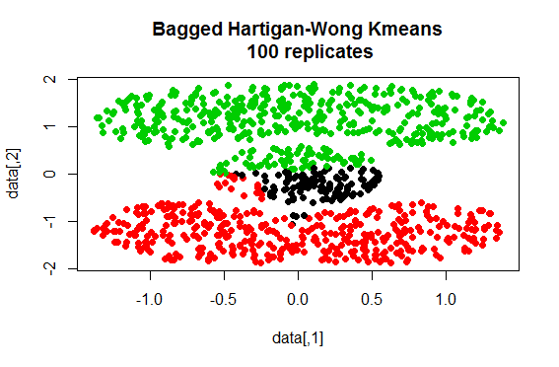
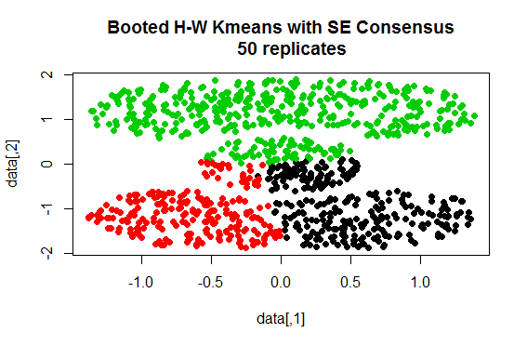
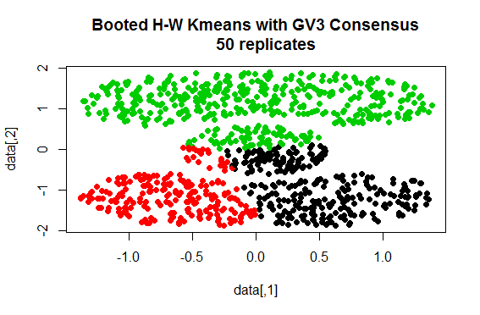
Boot Strap Kmeans: Bag_Clust1 vs (SE or GV3)

Slide 14
Single PAM vs Bagged Ensemble of PAM

Slide 15
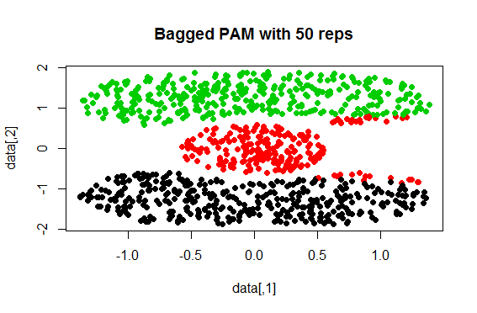
PAM with 50 Bagged Replicates

Slide 16
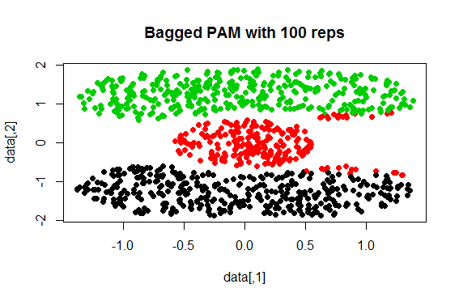
PAM with 100 Bagged Replicates

Slide 17

PAM with 200 Bagged Replicates

Slide 18
Toy Data – Conclusions
A single run of DBscan perfectly clusters this particular data
No amount of parameter tuning, and no ensemble, gets other algorithms up to par with DBscan – but PAM is much better than any version of kmeans
Find your best algorithm in the most simple way possible and then try to improve upon it with ensemble clustering
Don’t expect ensemble clustering to overcome the “sins” of using the wrong algorithm to begin with

Slide 19
Optimizing base clustering on Chicago data
Ongoing DePaul Housing Segmentation study has already used Pam K Medoids for many weeks and found it suitable to dataset
k = 8 clusters was found to be optimal by applying domain knowledge in the following ways:
Looking at cluster sizes when k is varied,
External validation – analysis of geographic plots for various k
Analyzing boxplots of all 35 - 40 variables per cluster when k is varied,
ANOVA tests on each variable’s mean differences between clusters.
k-means is too sensitive to outliers to use on noisy data such as this

Slide 20
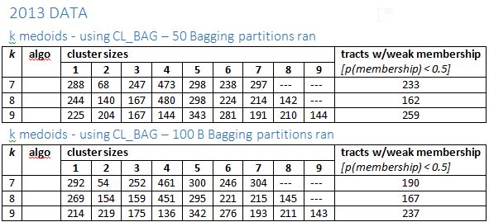
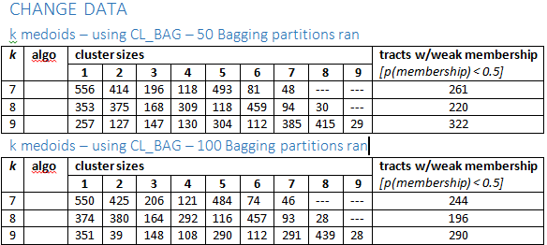
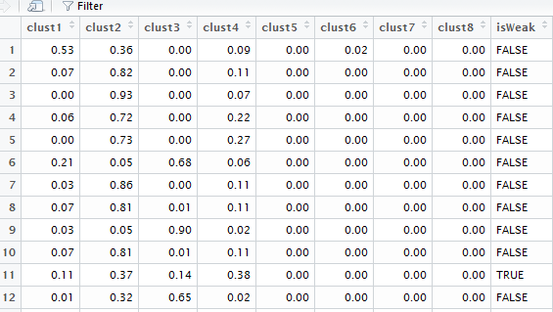
Choosing k=8 for Ensembles (weak membership reduction)
Looking at Cluster Sizes when k is varied can help decide optimal K, but requires domain knowledge.
k =7 has 2 clusters representing 55% of 1906 tracts?
Not realistic as Chicago is too diverse for such a result
Weak Member when row does not have any Probability > 0.5

Slide 21
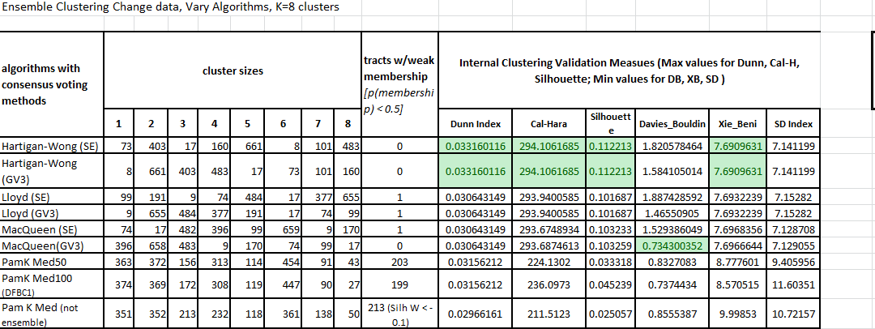
Don’t be fooled by Weak Membership alone
K Means Ensemble produces almost no weak members and scores well in Validation Indices
BUT….. Do the results make sense when you plot it?
DB index has a clue! Pam KMed100 is 2nd best; score differnce with MacQueen GV3 is small
DB index based on a ratio of within-cluster and between-cluster distances

Slide 22
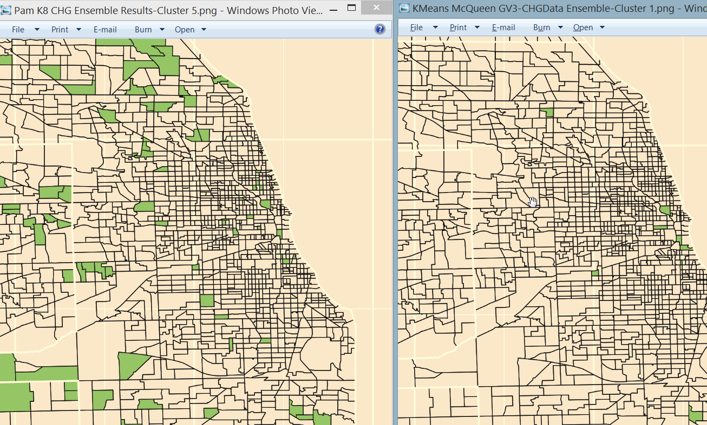
Compare “Wealth Cluster”: Pam k (119 members) vs kmeans (9 members)
Cluster 5 from PAM K Medoids Ensemble, which is a Wealthy Cluster with 119 tracts using Change Variables
K Means only found 9 Wealthy Tracts in equivalent cluster
Wrong Algorithm can give non-sensical results

Slide 23
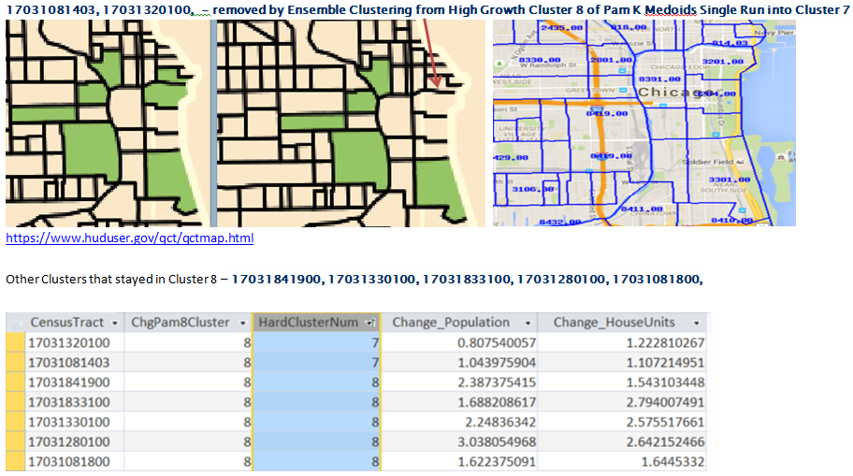
Ensemble Can Refine Clustering Results
Chicago Loop Example: 2 census tracts re-assigned from High Growth(8) to Medium Growth Cluster(7)
Re-assignment seem reasonable when 2 strongest variables for High Growth is examined

Slide 24
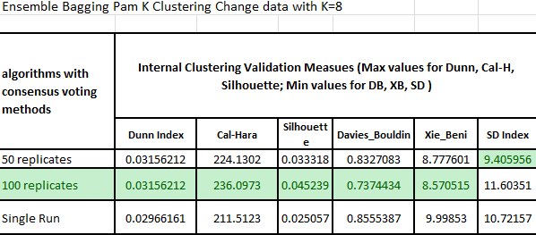
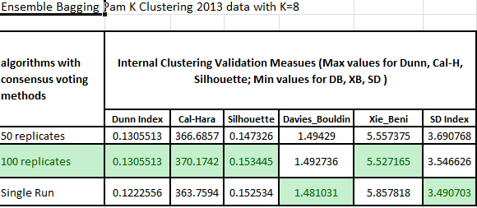
Pam K Internal Validation Indices- Ensemble Wins
Ensemble Pam K does score well in most Validation Indices. Improvement happens with more parallel runs ( 50 vs 100)
Dunn’s Index is more appropriate to use when K is being varied and algorithms changing. The denominator in formula is K which is fixed at 8 in this slide.
Inter-cluster distance metric is the numerator, which is likely not varying much for the same algorithm
Minimizing Indices(DB, XB) are a ratio of compactness and separation properties
SD uses the variance of dataset & clusters to measure scatter + distance
Calinski-Harabasz is ratio of between cluster variance/within cluster variance

Slide 25
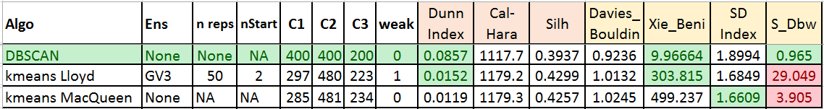
Choose Internal Validity Measures Wisely
Applying the wrong validity measure to a partitioning method or dataset can be misleading
The internal validity measures we use for Chicago data+PAM are NOT applicable to Toy data + DBSCAN
For a density-based clustering, use S-Dbw (Scatter + Distance Between)
= the sum of the mean dispersion plus the between-cluster density – try to minimize
Kmeans variants, which are worst on external validation, come out 'best' if we use the wrong internal validity measures
When we use the correct internal validity measures, we see DBscan far outperforms the other approaches.

Slide 26
Choose Internal Validity Measures Wisely (2) -- Toy Data External Validation

Slide 27
Visualizing results: NOW data Bagging with Clustering ensemble vs single PAM partition

Slide 28
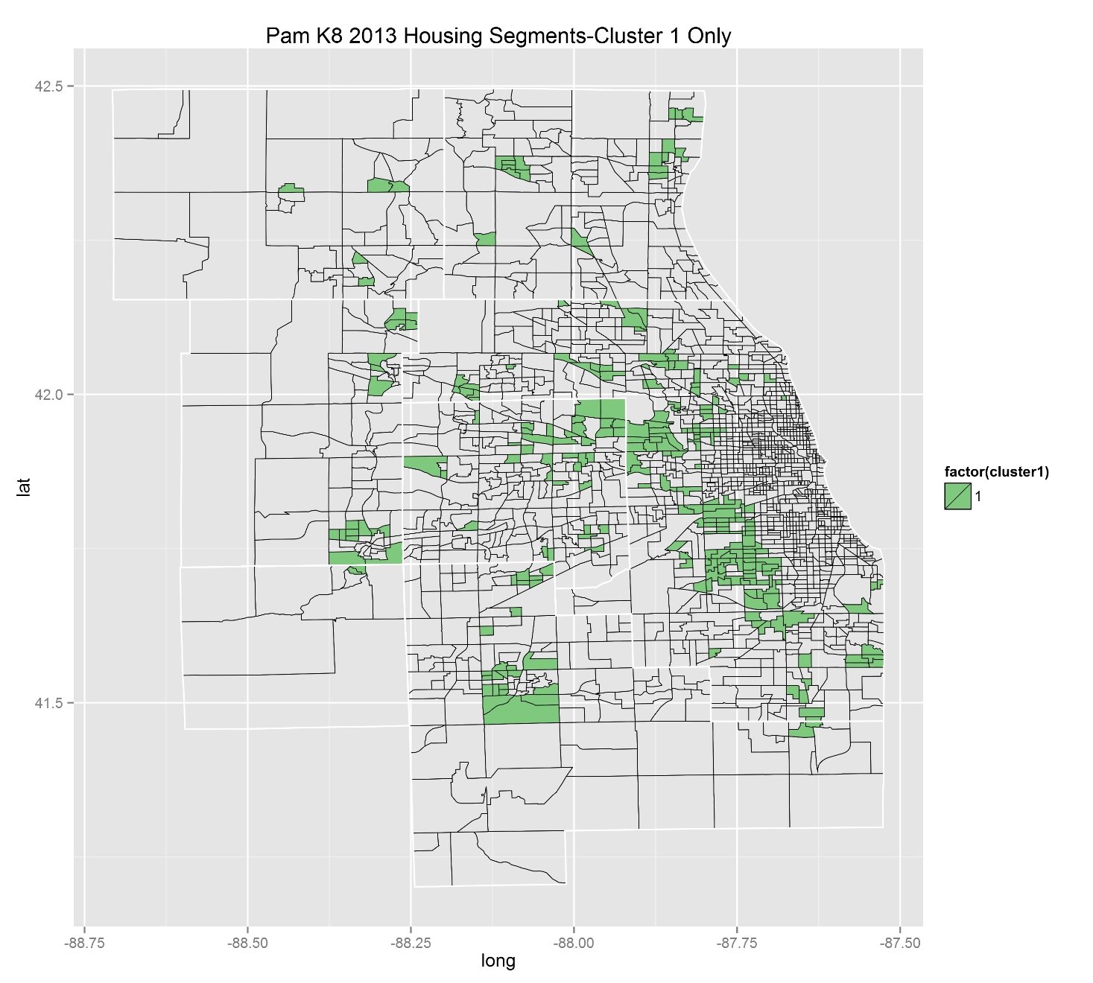
NOW DATA Cluster 1 Before Ensemble

Slide 29
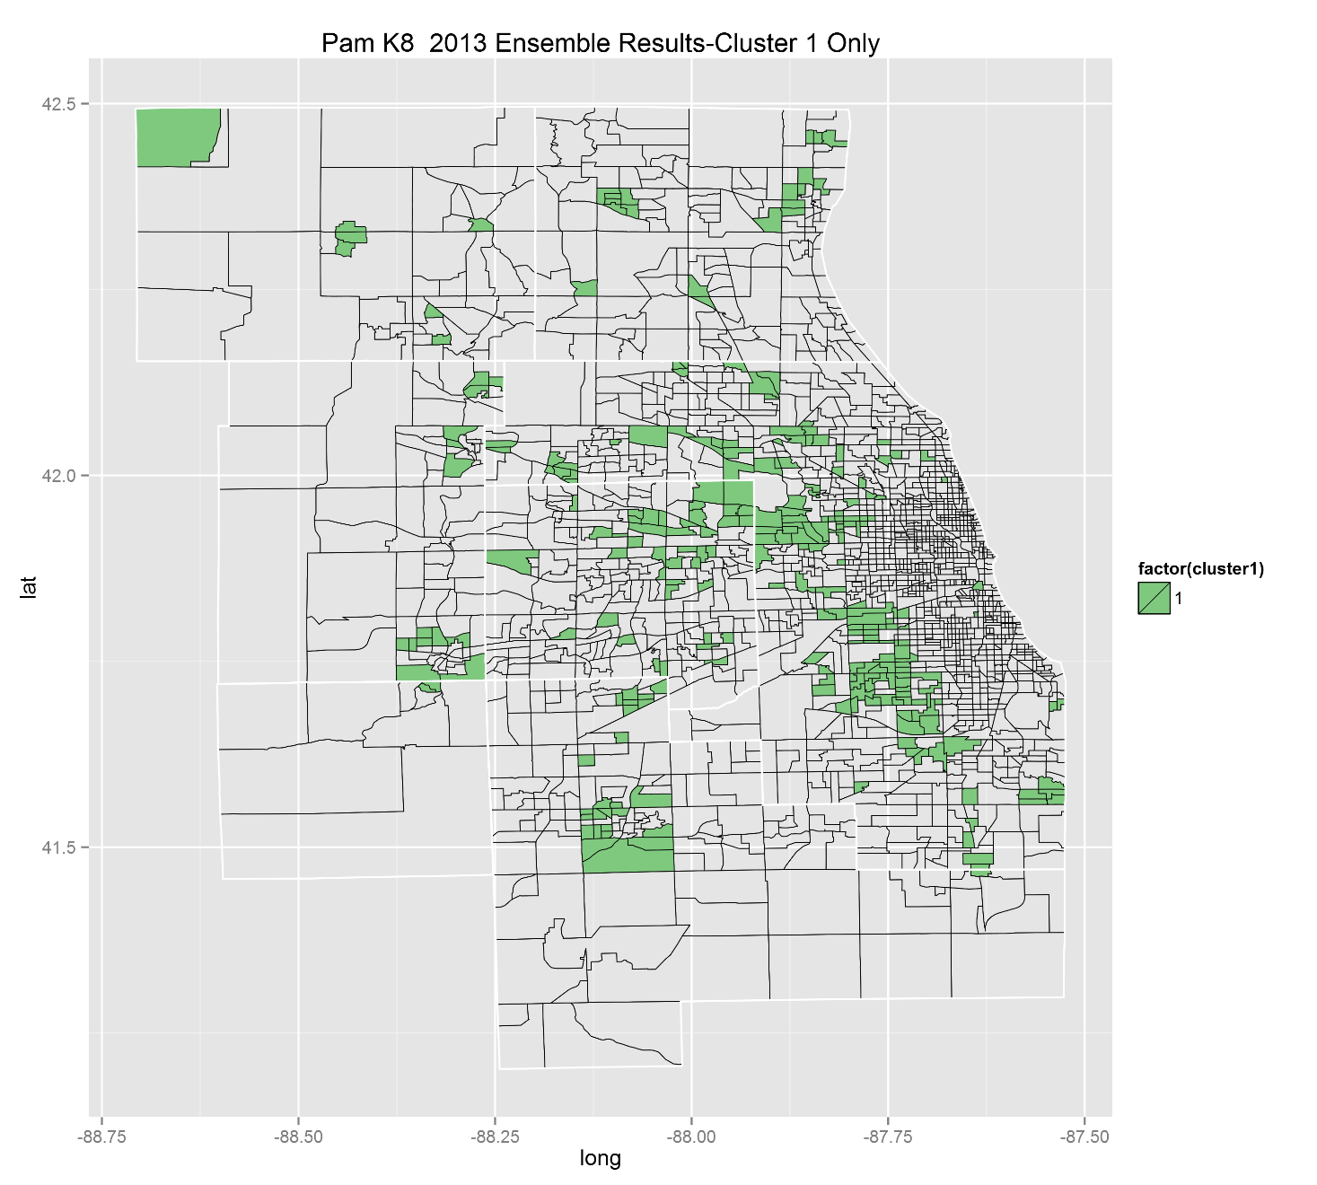
NOW DATA Cluster 1 After Ensemble

Slide 30
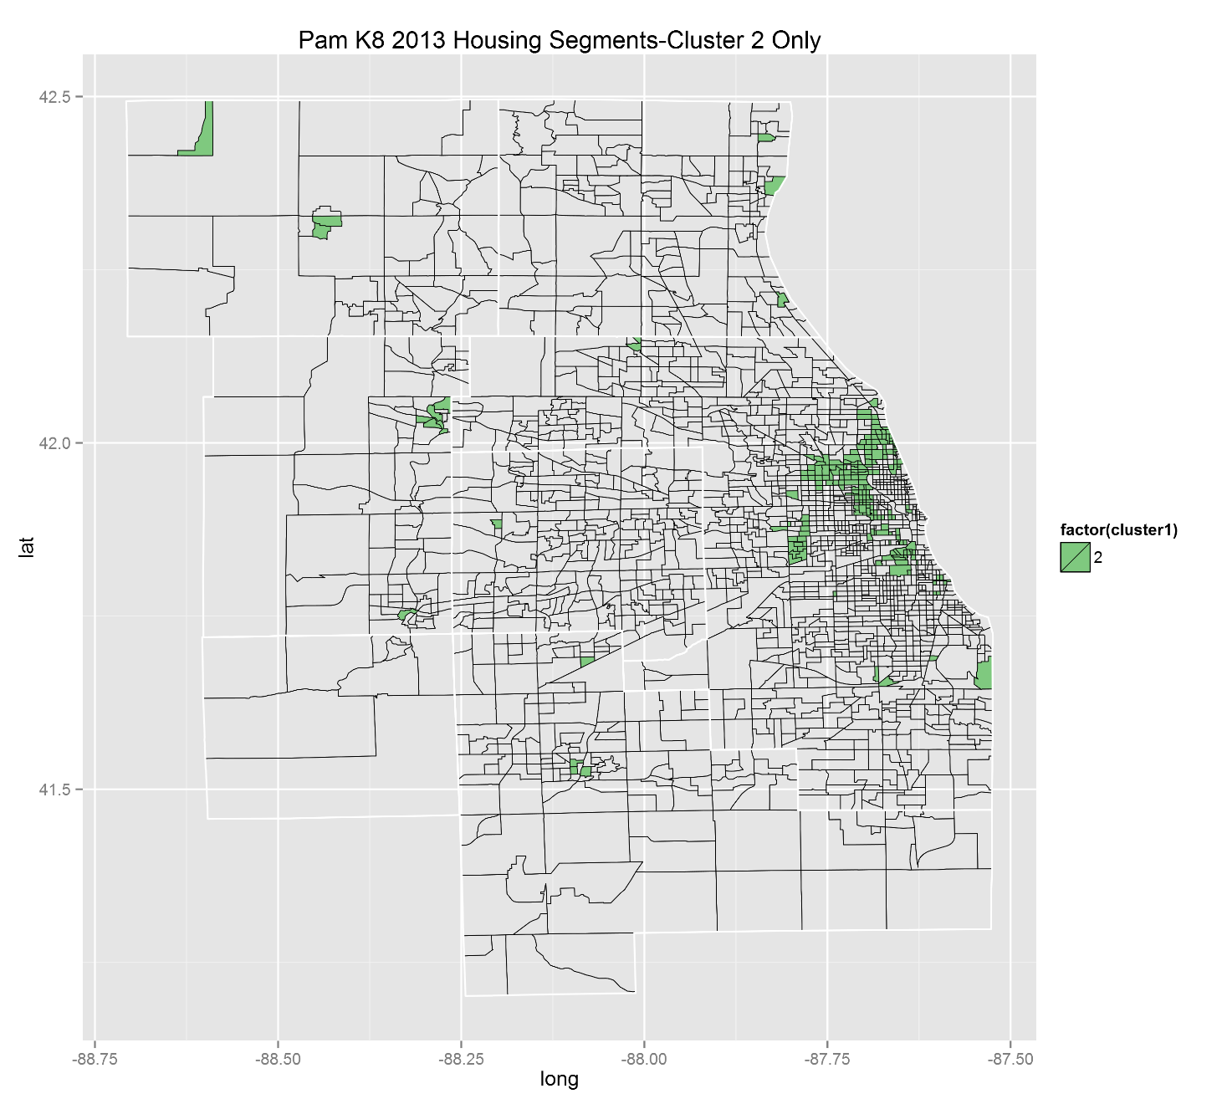
NOW DATA Cluster 2 Before Ensemble

Slide 31
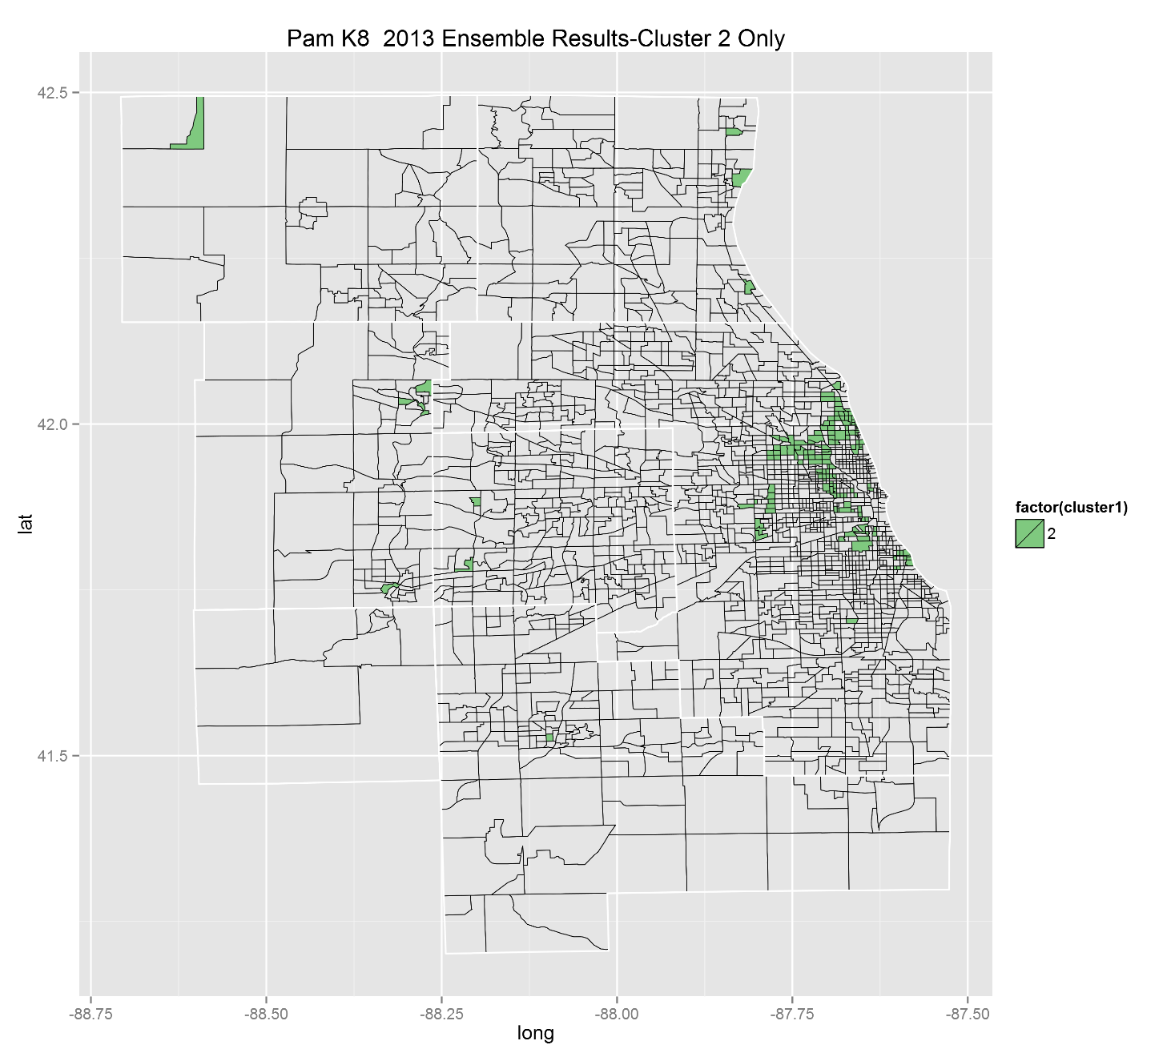
NOW DATA Cluster 2 After Ensemble

Slide 32
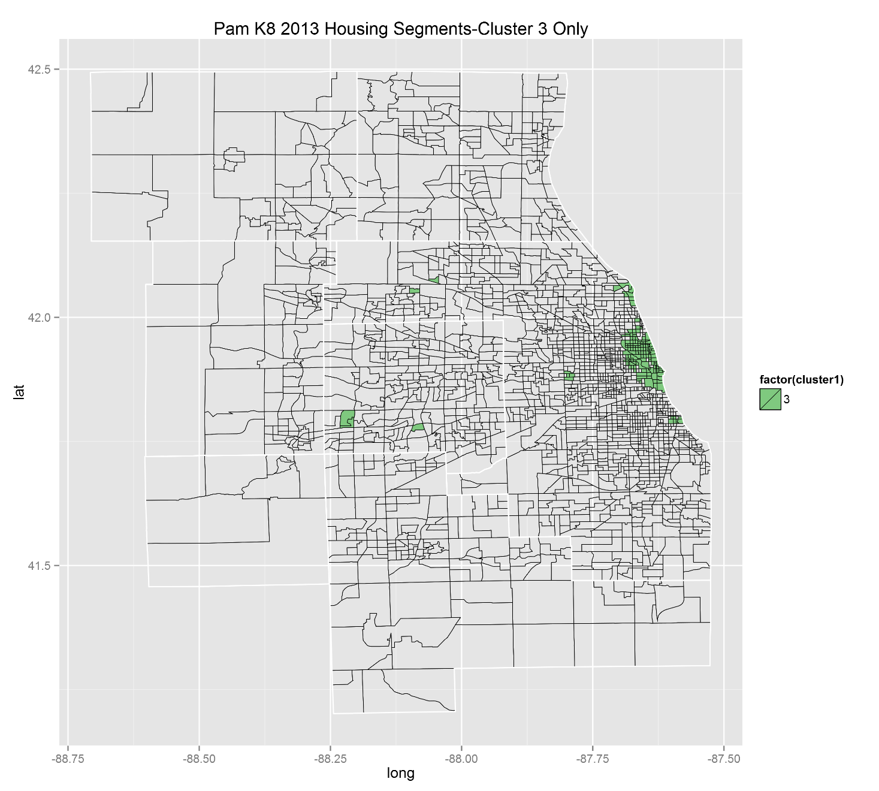
NOW DATA Cluster 3 Before Ensemble

Slide 33
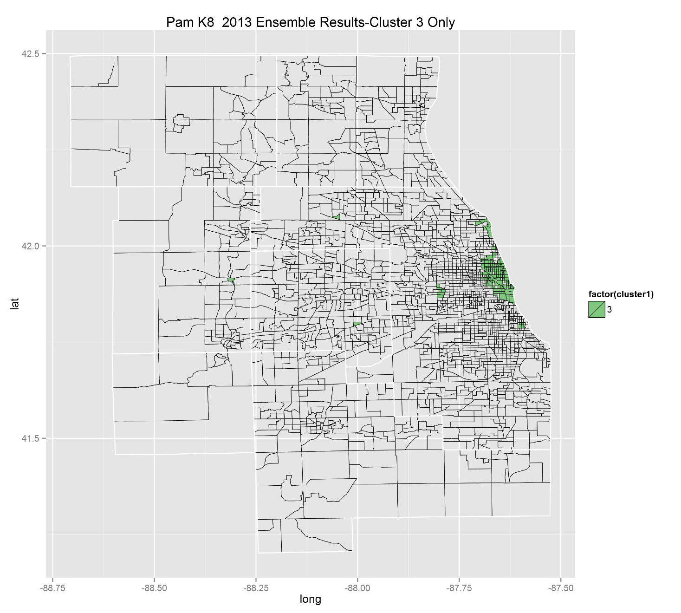
NOW DATA Cluster 3 After Ensemble

Slide 34
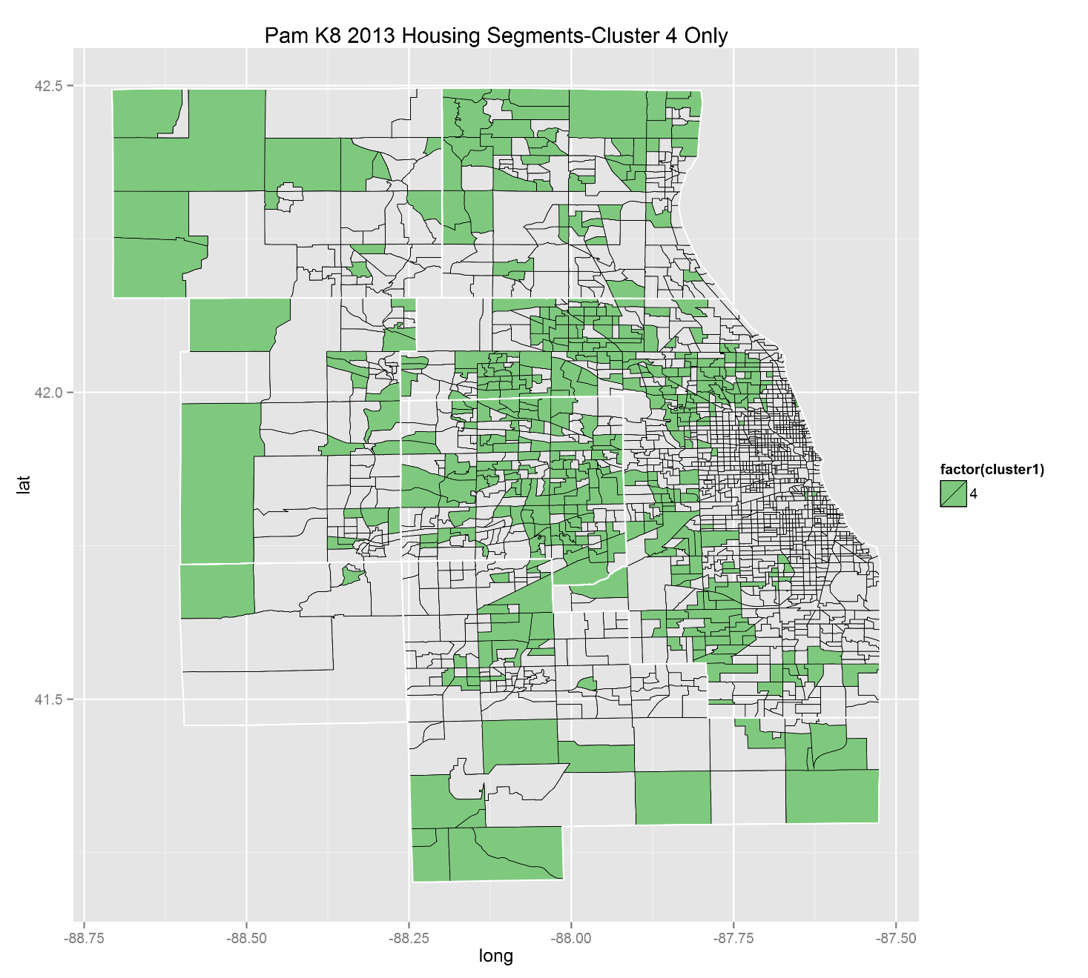
NOW DATA Cluster 4 Before Ensemble

Slide 35
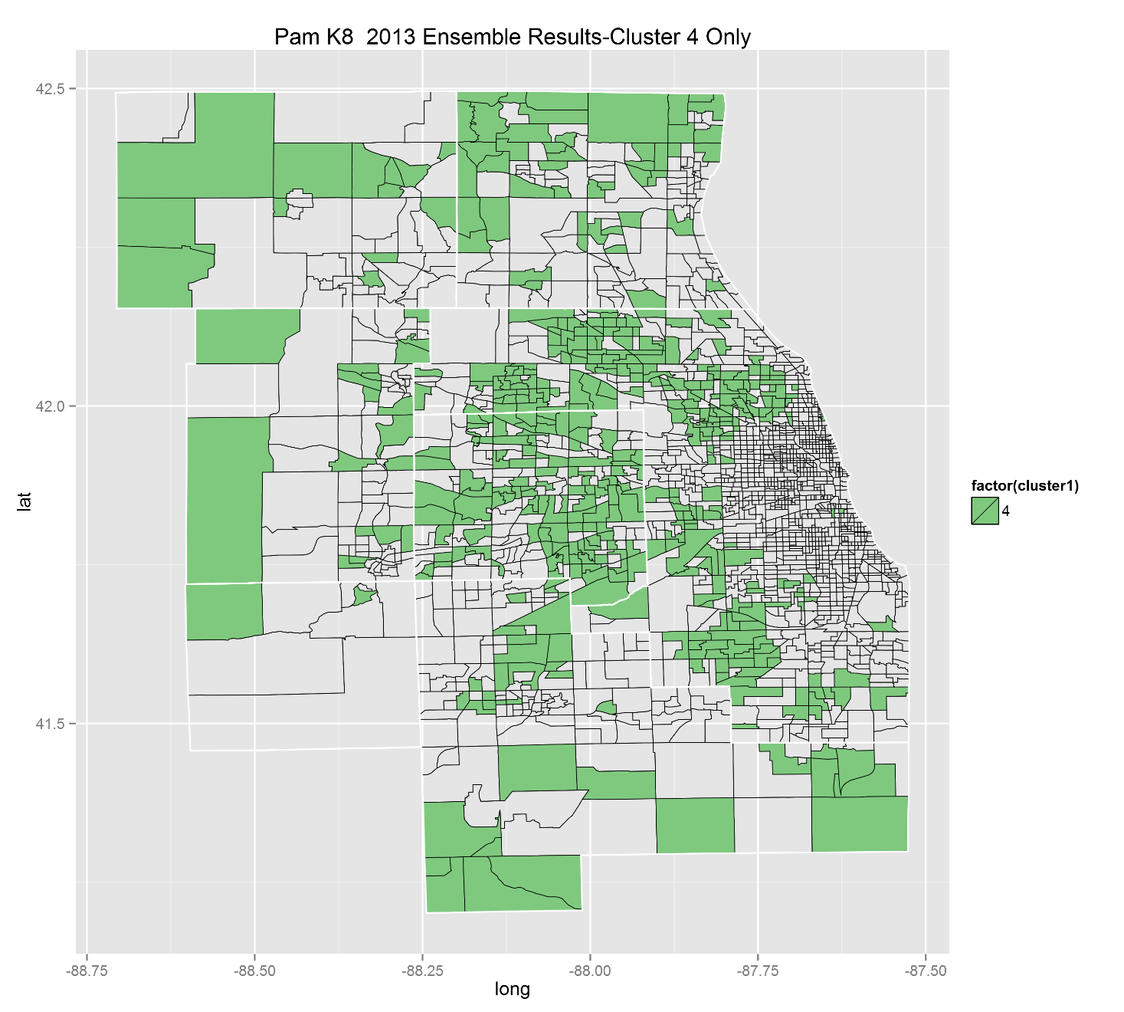
NOW DATA Cluster 4 After Ensemble

Slide 36
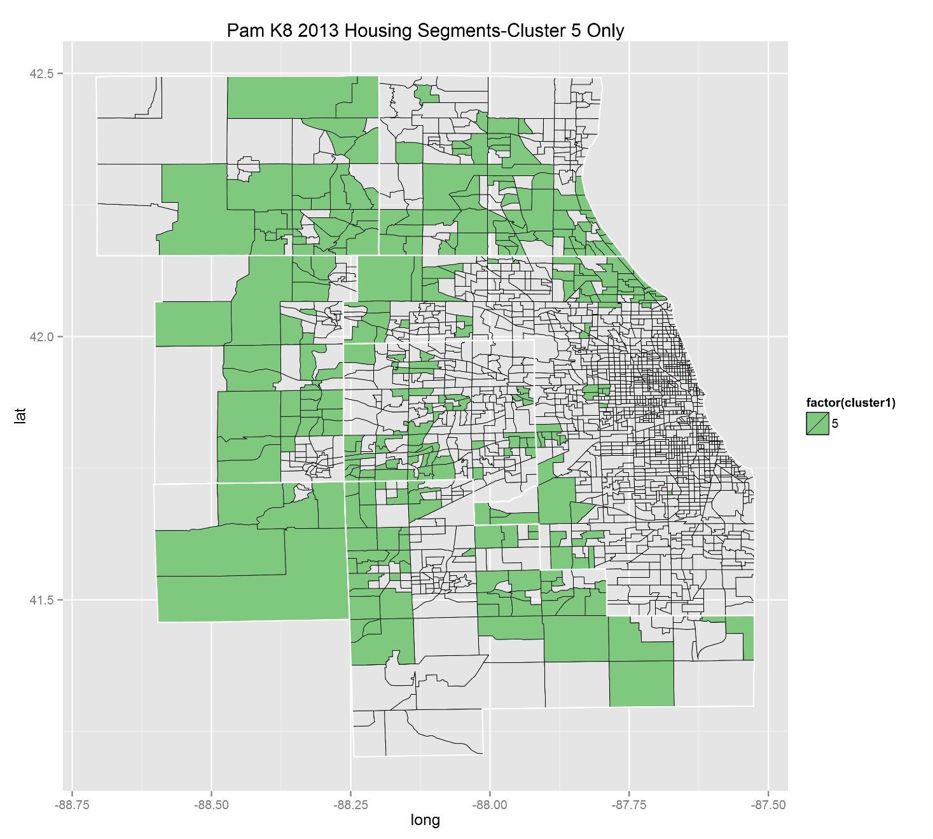
NOW DATA Cluster 5 Before Ensemble

Slide 37

NOW DATA Cluster 5 After Ensemble

Slide 38
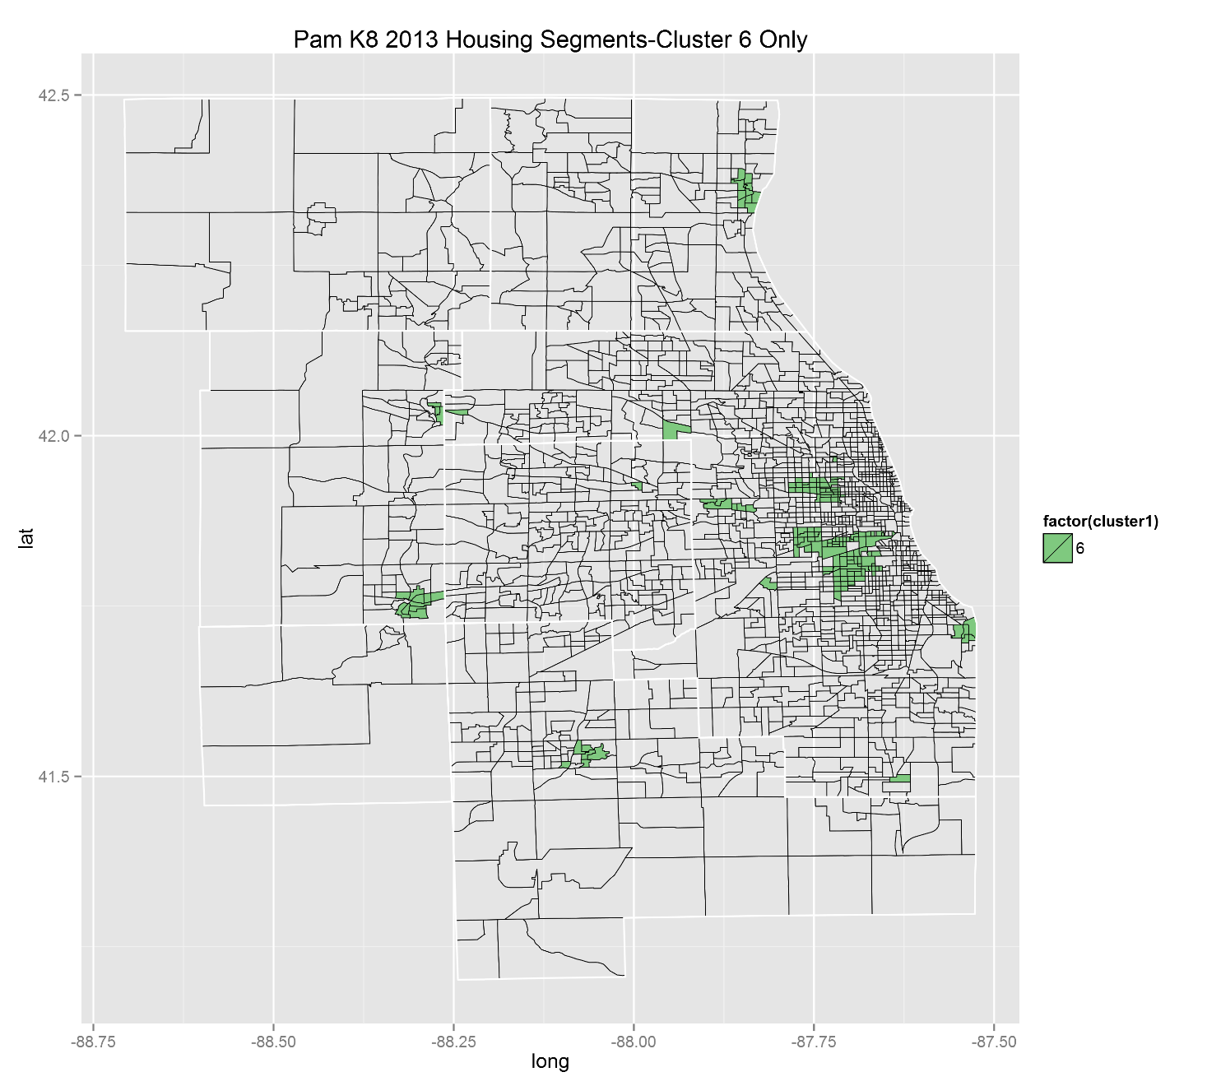
NOW DATA Cluster 6 Before Ensemble

Slide 39
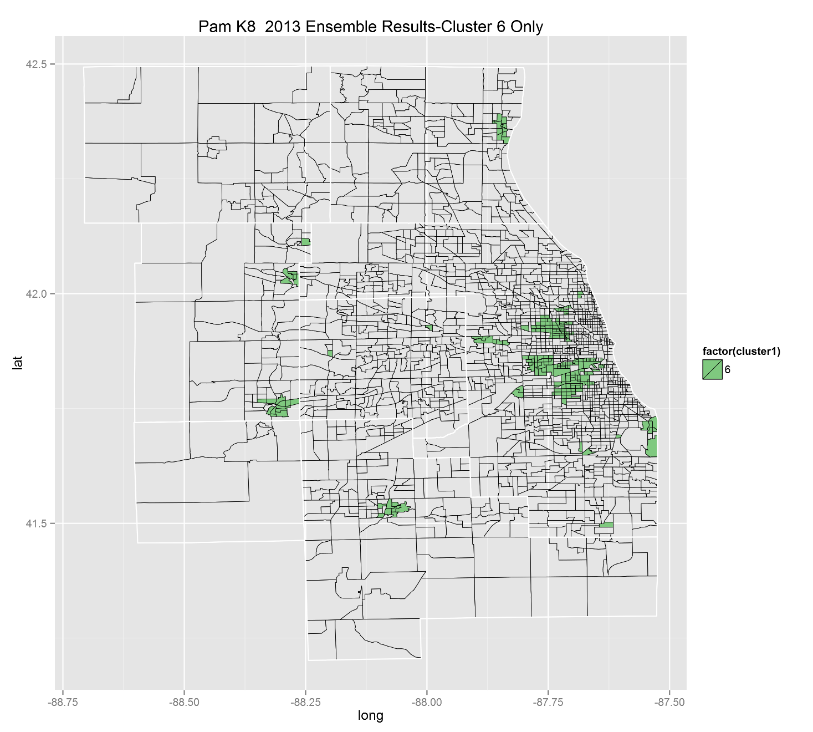
NOW DATA Cluster 6 After Ensemble

Slide 40
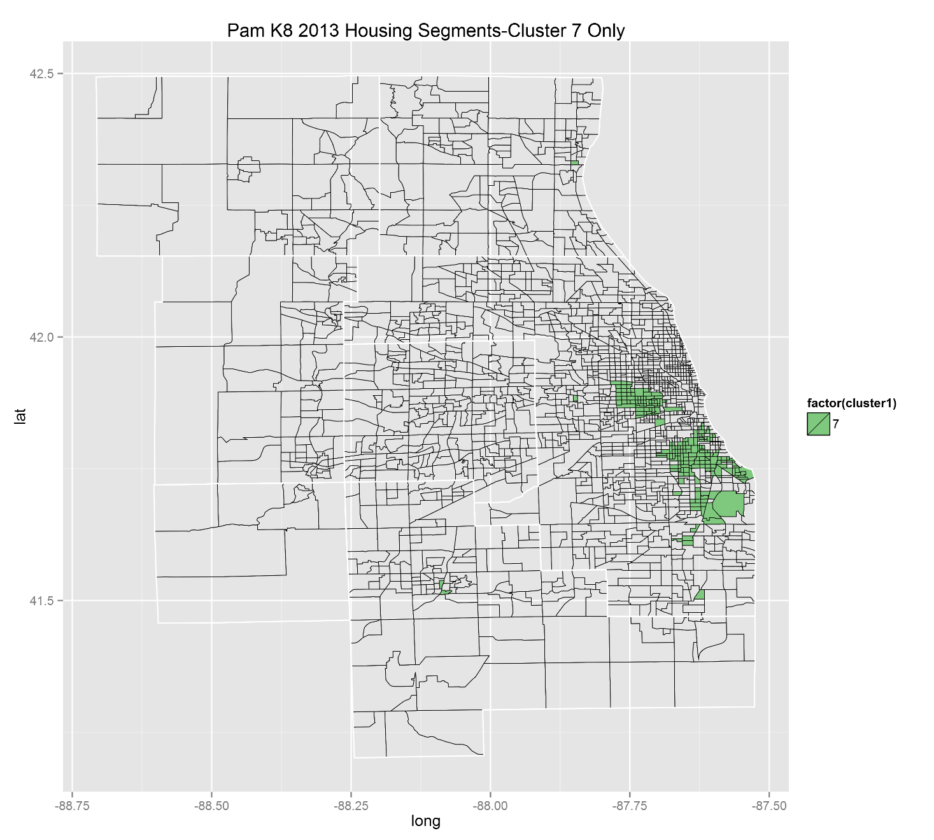
NOW DATA Cluster 7 Before Ensemble

Slide 41

NOW DATA Cluster 7 After Ensemble

Slide 42
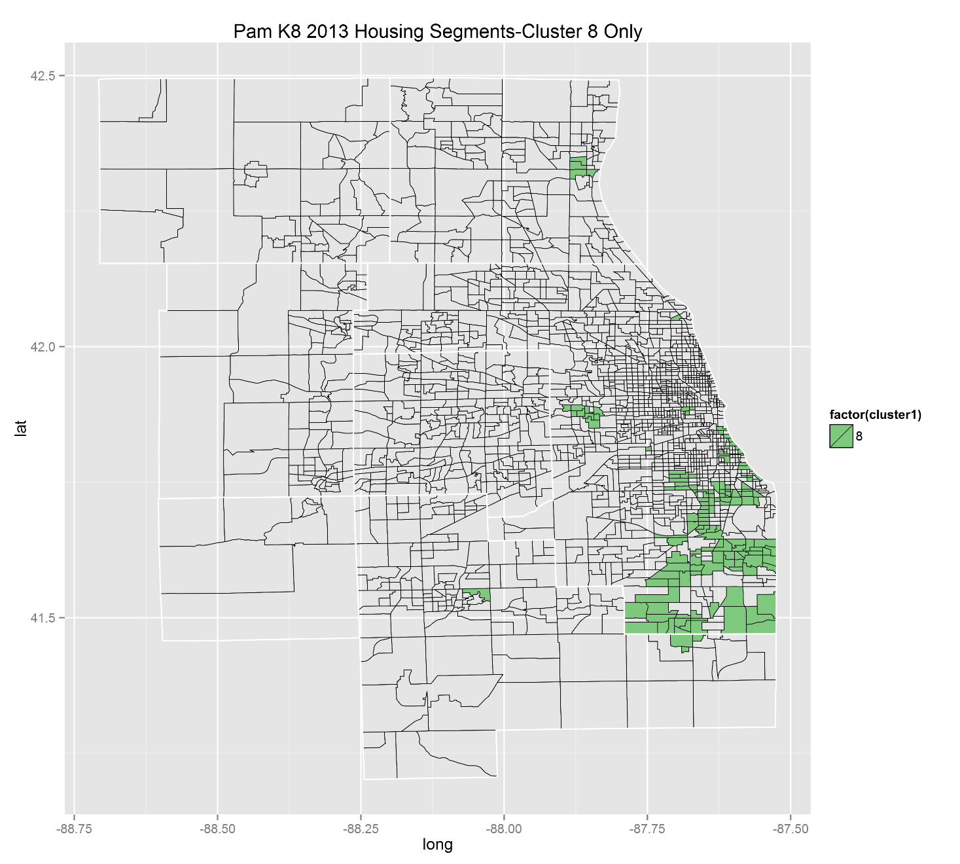
NOW DATA Cluster 8 Before Ensemble

Slide 43

NOW DATA Cluster 8 After Ensemble

Slide 44
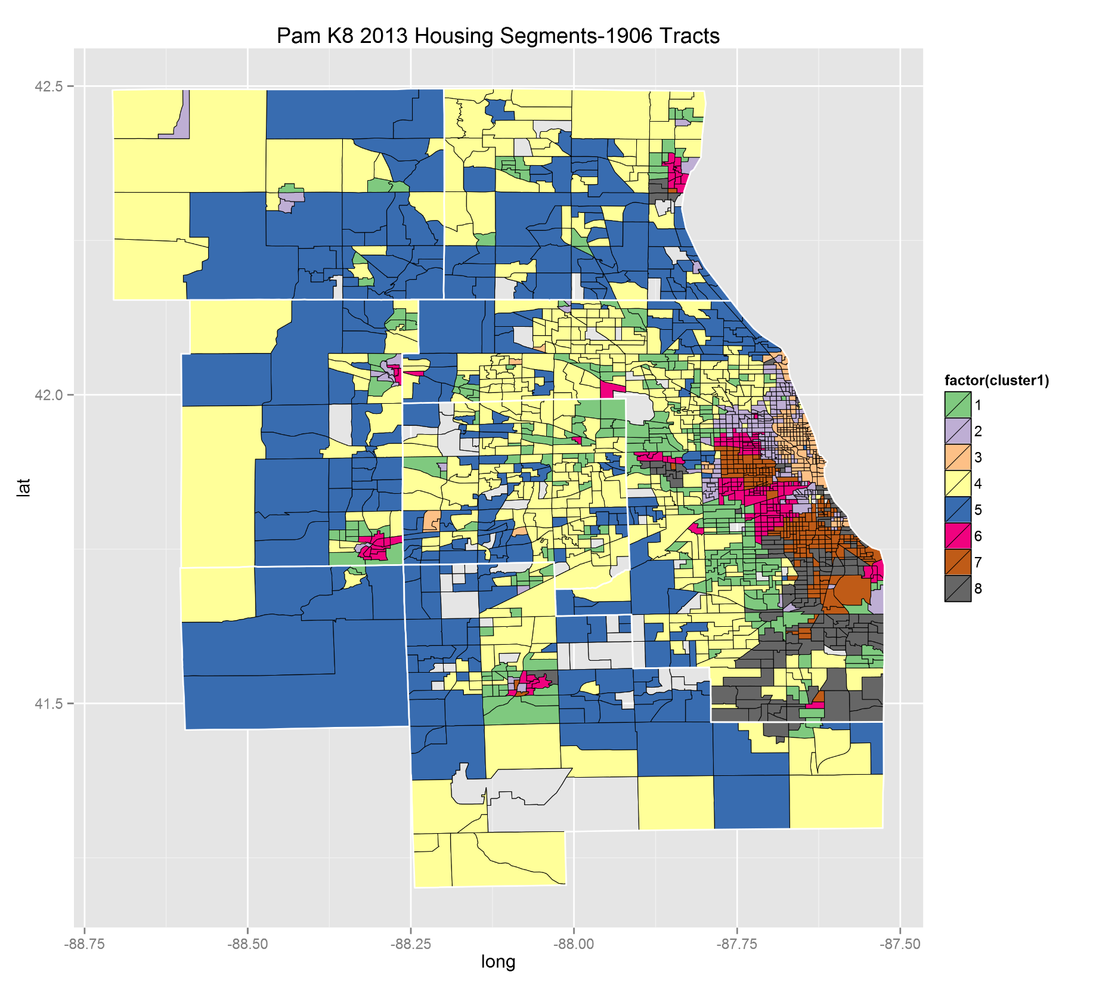
NOW DATA
All Clusters
Before Ensemble

Slide 45
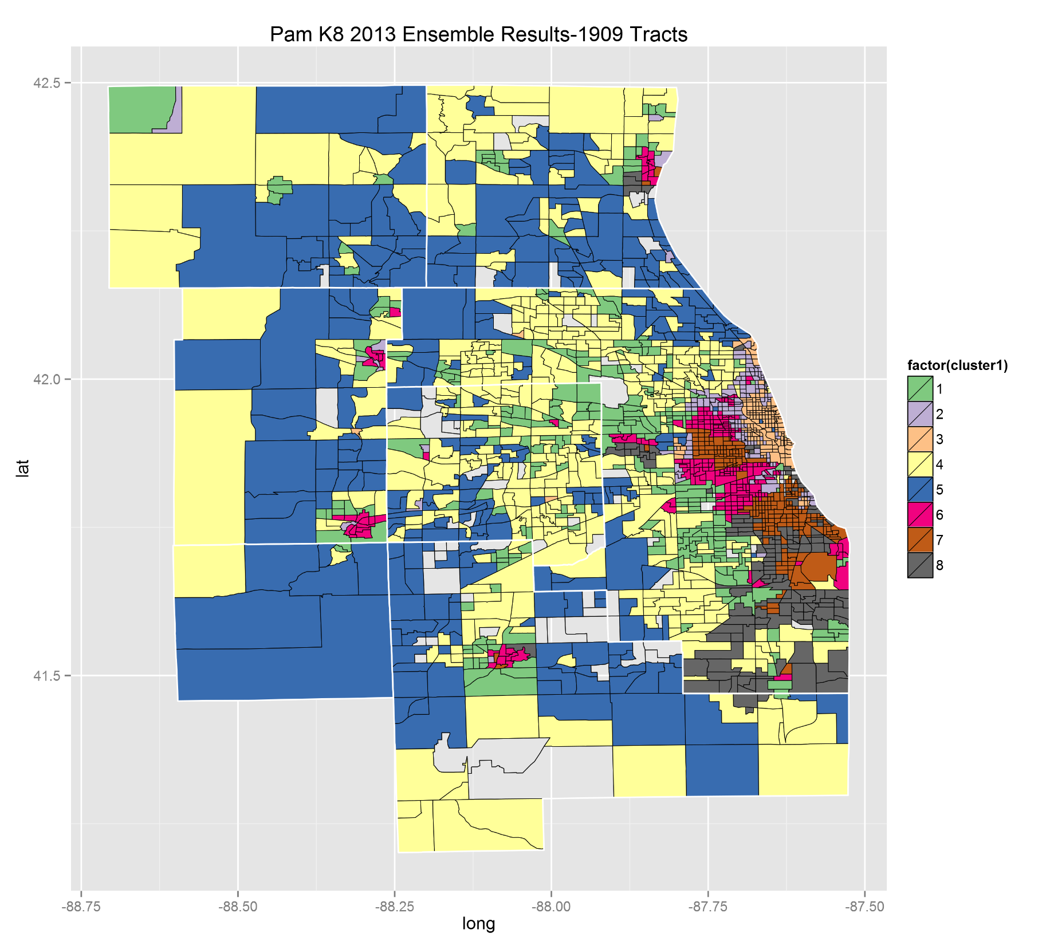
NOW DATA
All Clusters
After Ensemble

Slide 46
Visualizing results: CHANGE data Bagging with Clustering ensemble vs single PAM partition

Slide 47
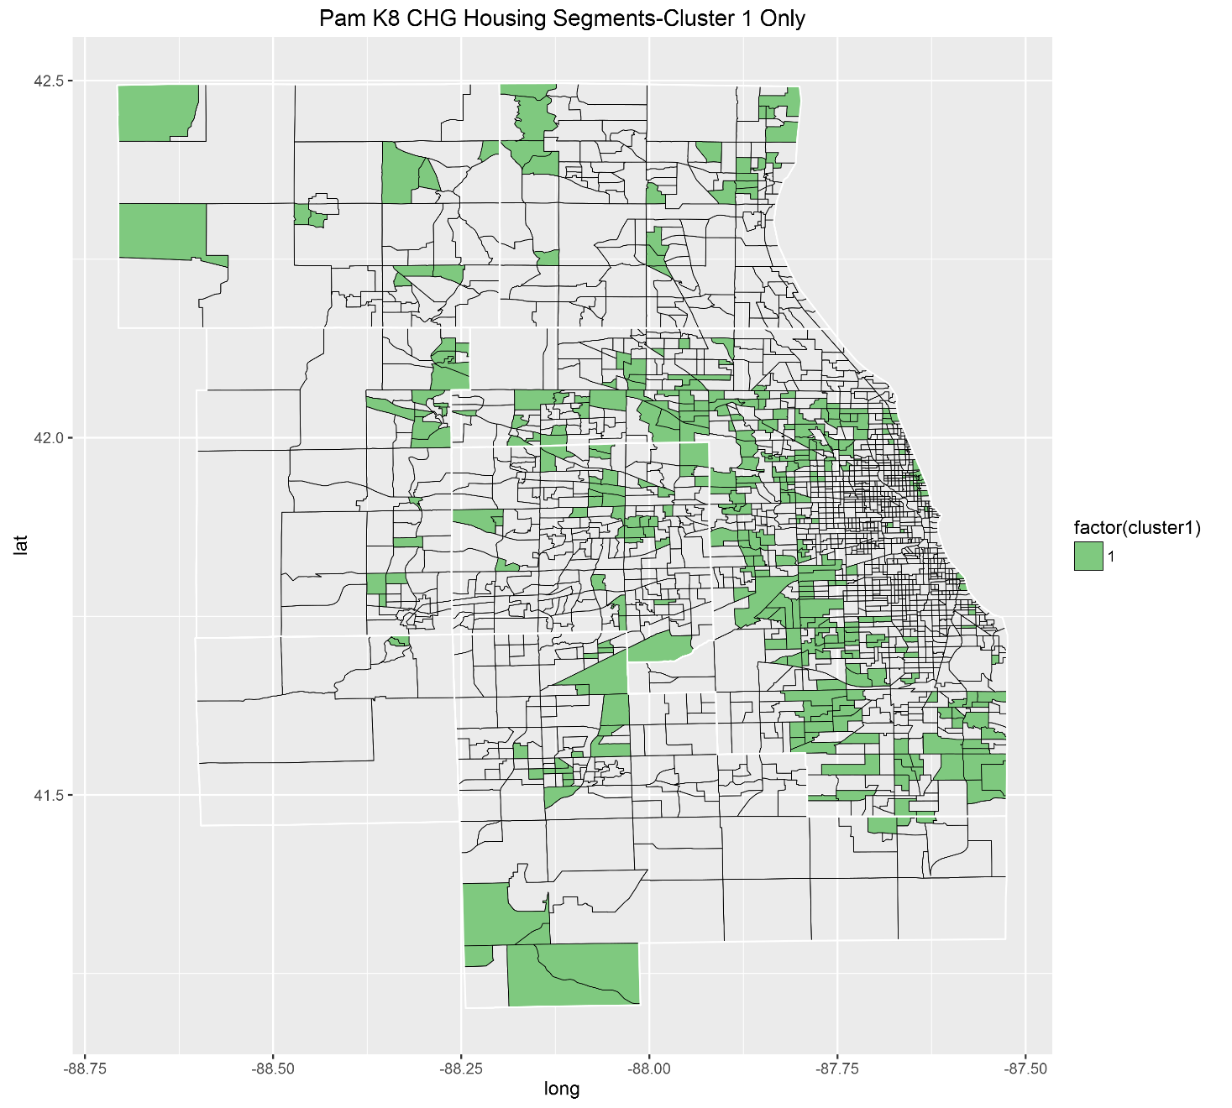
CHANGE DATA Cluster 1 Before Ensemble

Slide 48
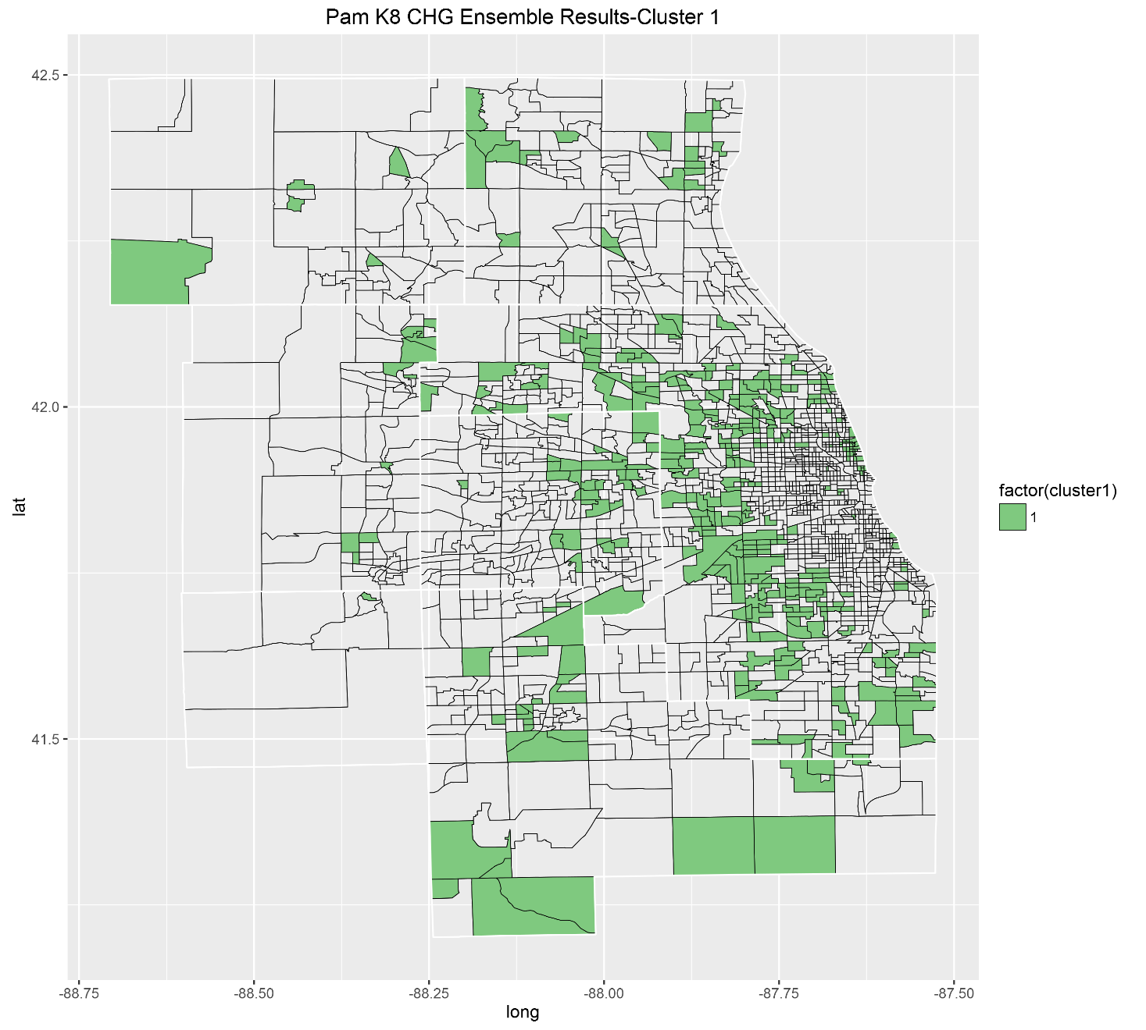
CHANGE DATA Cluster 1 After Ensemble

Slide 49
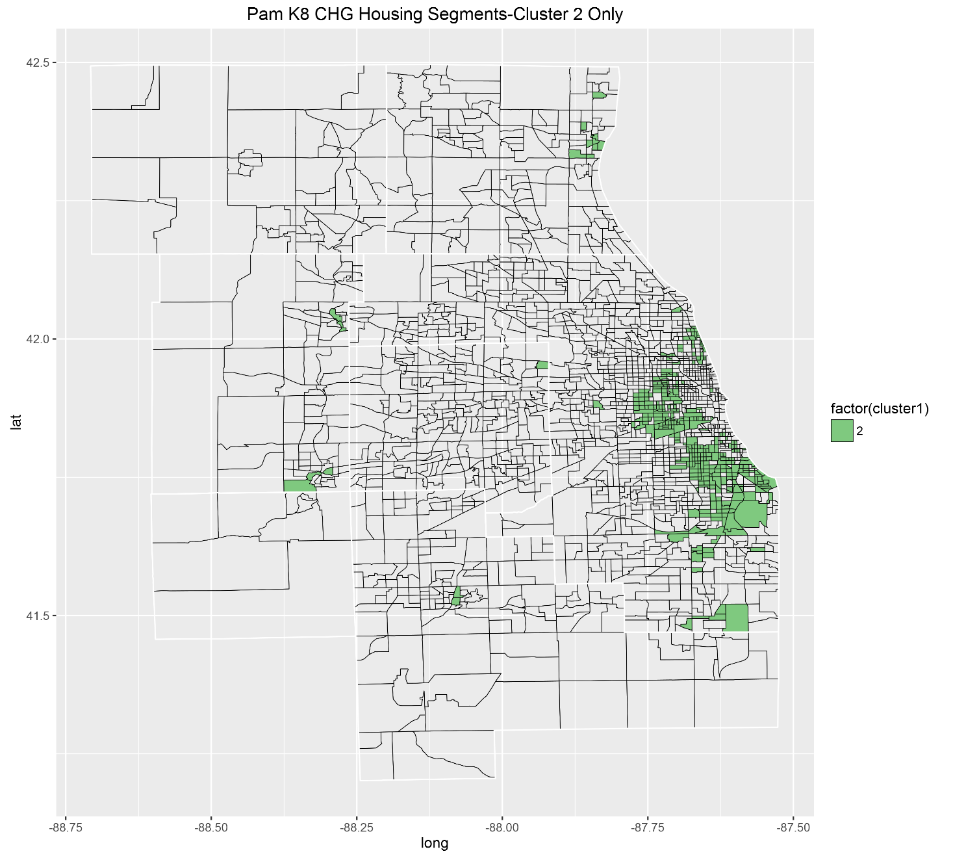
CHANGE DATA Cluster 2 Before Ensemble

Slide 50

CHANGE DATA Cluster 2 After Ensemble

Slide 51
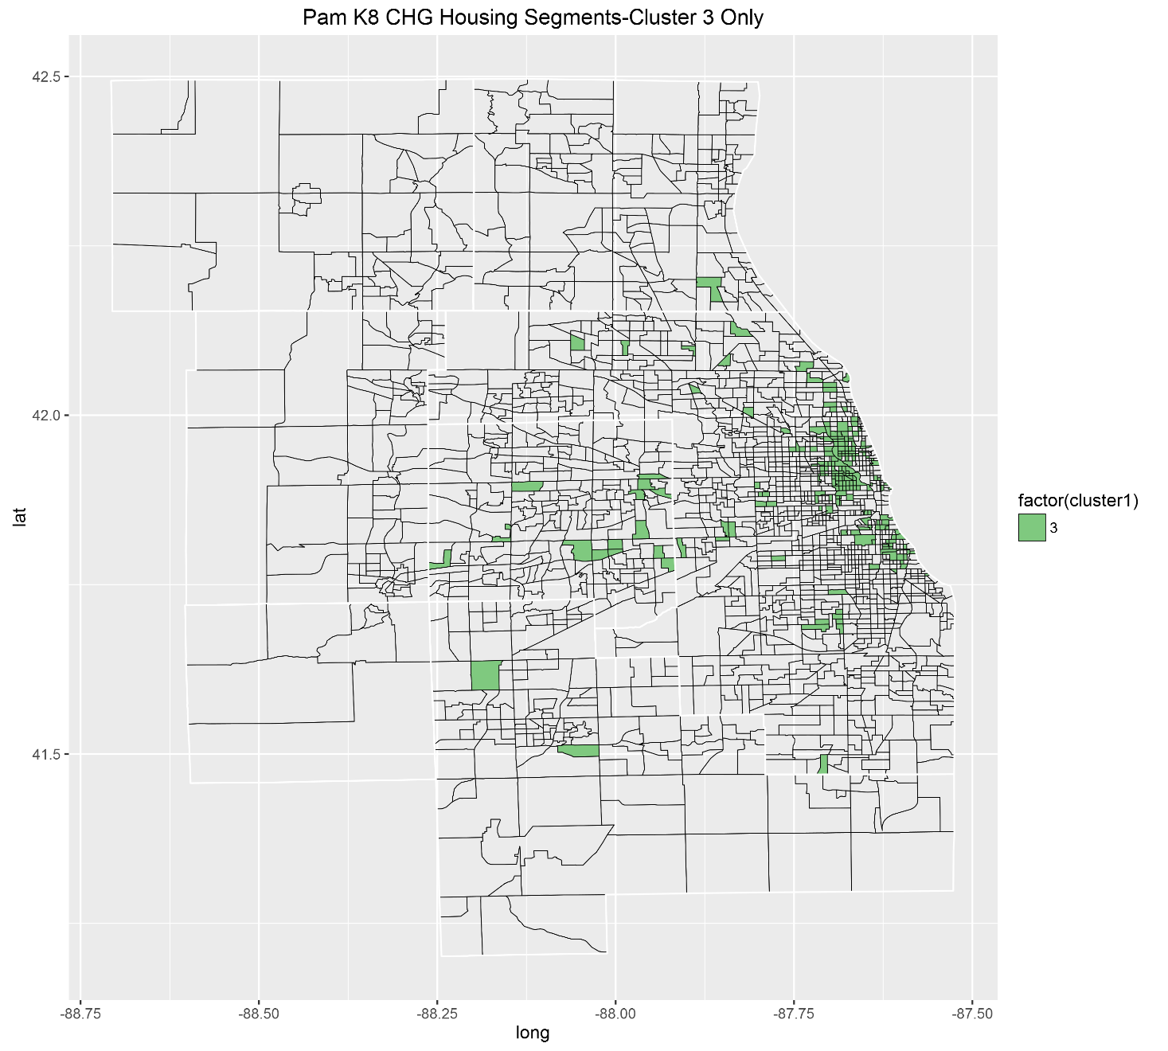
CHANGE DATA Cluster 3 Before Ensemble

Slide 52
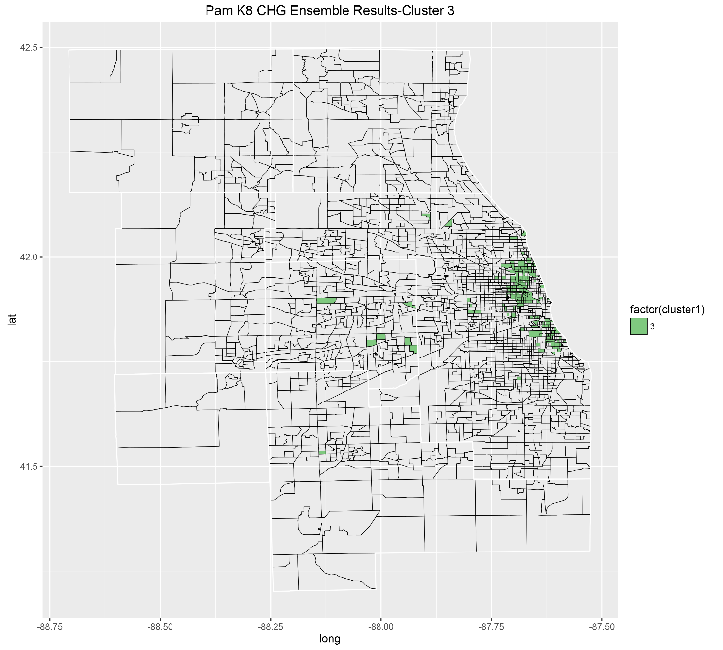
CHANGE DATA Cluster 3 After Ensemble

Slide 53
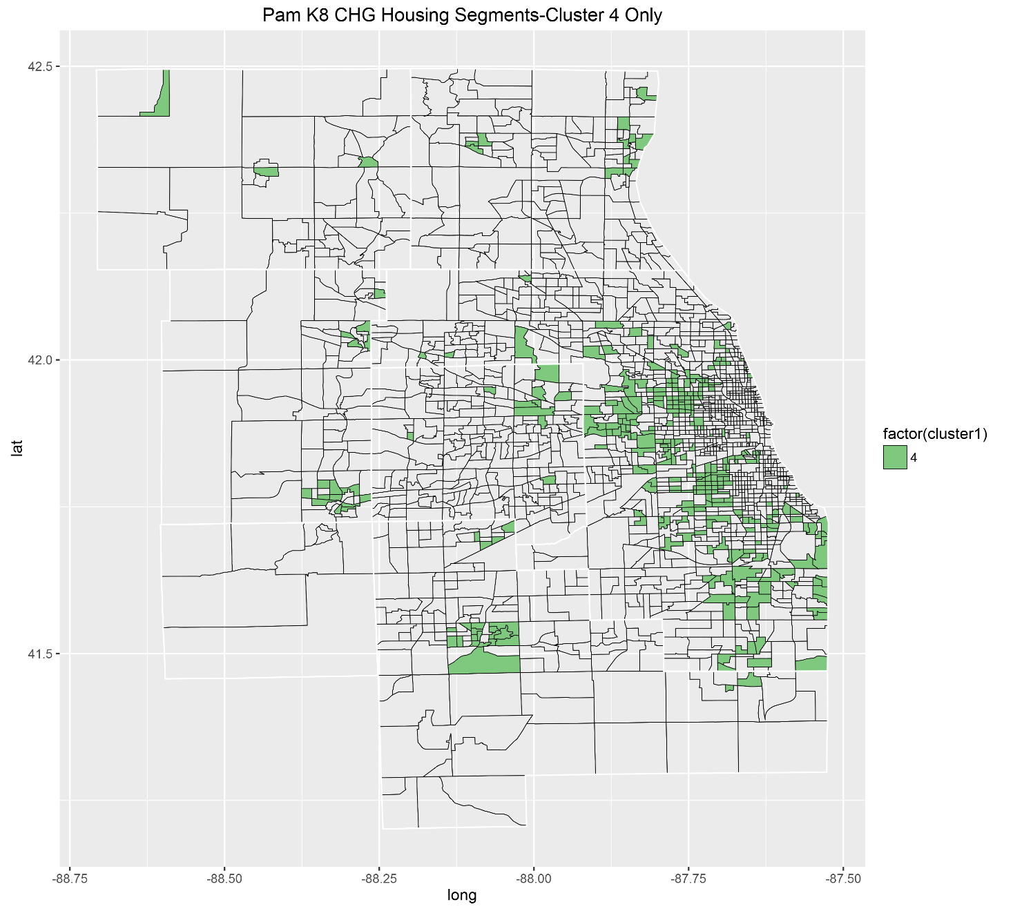
CHANGE DATA Cluster 4 Before Ensemble

Slide 54
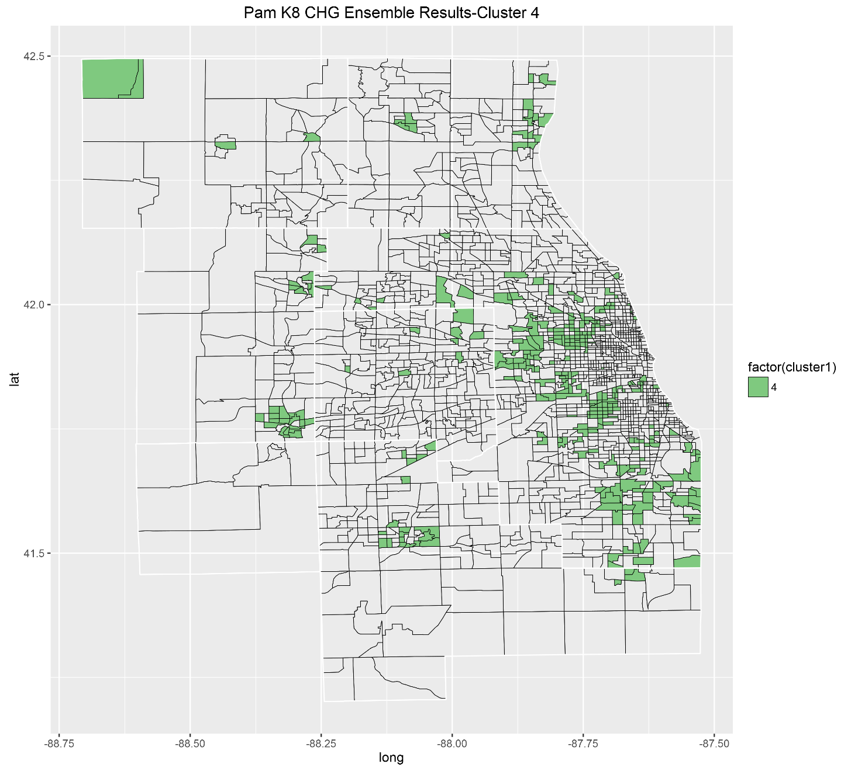
CHANGE DATA Cluster 4 After Ensemble

Slide 55

CHANGE DATA Cluster 5 Before Ensemble

Slide 56

CHANGE DATA Cluster 5 After Ensemble

Slide 57

CHANGE DATA Cluster 6 Before Ensemble

Slide 58

CHANGE DATA Cluster 6 After Ensemble

Slide 59

CHANGE DATA Cluster 7 Before Ensemble

Slide 60

CHANGE DATA Cluster 7 After Ensemble

Slide 61

CHANGE DATA Cluster 8 Before Ensemble

Slide 62

CHANGE DATA Cluster 8 After Ensemble

Slide 63


CHANGE DATA
All Clusters
Before Ensemble

Slide 64

CHANGE DATA
All Clusters
After Ensemble

Slide 65
Limitations & Future Work
Our sample sizes are small compared to the genome data these techniques were developed for
Cluster Stability - Cluster labels change with each new run/algorithm, difficult to compare results without re-labelling/reconciling cluster A became B. Even with same seed, ensemble cluster results vary slightly between runs.
Try assigning weights to features when voting results and varying weights in a systematic way to allow comparisons. (Grid Search of : Nstart, K, Distance Metrics, Consensus Methods, Attribute Weighting, # of Sample Replicates, Proportion of Sample Sizes per Replicate)
Without tools to automate Grid Search, not feasible for this project and likely not computationally possible without large machines or very long computation times.

